Slide 1
Computer Architecture
Coursework 2 – Circuit Optimisation

Slide 2
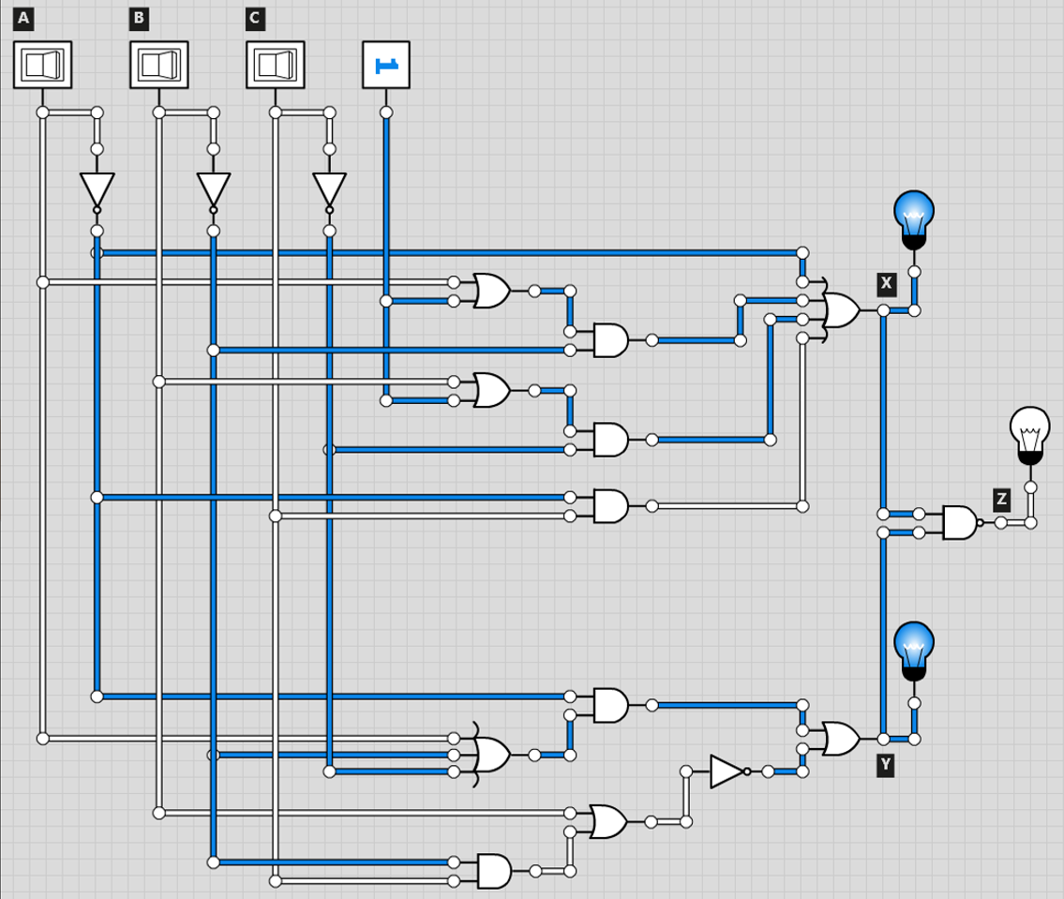
Circuit 1

Slide 3
Section X
Section Y
A' | + | B'(1 + A) | + | C'(1 + B) | + | A'C
A' | + | B'(1)____ | + | C'(1)____ | + | A'C
A' | + | B'_______ | + | C'_______ | + | A'C
A'(A | + | __B' | + | ___C') | + | (B'C | + | ____B)'
A' A | + | A'B' | + | A'C' | + | __B'C' | + | B'B
0 | + | A'B' | + | A'C' | + | __B'C' | + | 0
A' | + | A'C | = | A'(1 + C)
 |  |  | = | A'(1)____
 |  |  | = | A'_______
Solution: | A'B' | + | A'C' | + | B'C'
Solution: | A' | + | B' | + | C'
Circuit 1: Section X |  | C
 |  | 0 | 1
AB | 00 | 1 | 1
 | 01 | 1 | 1
 | 11 | 1 | 0
 | 10 | 1 | 1
Values: | A' + B' + C'
Circuit 1: Section Y |  | C
 |  | 0 | 1
AB | 00 | 1 | 1
 | 01 | 1 | 0
 | 11 | 0 | 0
 | 10 | 1 | 0
Values: | A'B' + A'C' + B'C'

Slide 4
Section Z
 |  | X' |  |  | + |  |  |  | Y'
(A' | + | B' | + | C')' | + | _(A'B' | + | A'C' | + | ___B'C')'
 |  | ABC |  |  | + | (AAB | + | AAC | + | ACB | + | ACC
 |  |  |  |  |  | _BAB | + | BAC | + | BCB | + | _BCC)
 |  |  |  |  |  | AB | + | AC | + | ABC | + | AC
 |  |  |  |  |  | AB | + | ABC | + | BC | + | BC
 |  | ABC |  |  | + | ABC | + | AB | + | AC | + | BC
ABC | + | AB | = | AB(1 + C)
 |  |  | = | AB(1)____
 |  |  | = | AB_______
Circuit 1: Section Z |  | C
 |  | 0 | 1
AB | 00 | 0 | 0
 | 01 | 0 | 1
 | 11 | 1 | 1
 | 10 | 0 | 1
Values: | AB + AC + BC
Solution: | AB | + | AC | + | BC

Slide 5
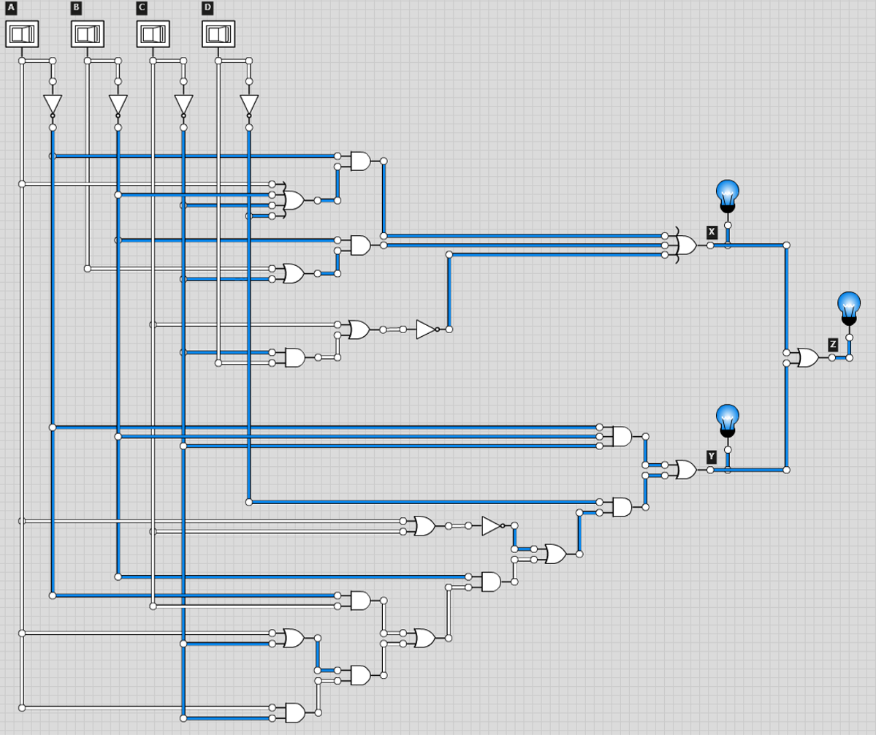
Circuit 2

Slide 6
Section X
A' | _(A | + | B' | + | C' | + | ___D') | + | B' | _(B | + | ___C') | + | (C |  | + | _C'D)'
 | A'A | + | A'B' | + | A'C' | + | A'D' | + |  | B'B | + | B'C' | + | __C' | _(C | + | ___D')
 | A'A | + | A'B' | + | A'C' | + | A'D' | + |  | B'B | + | B'C' | + |  | C'C | + | C'D'
 | 0 | + | A'B' | + | A'C' | + | A'D' | + |  | 0 | + | B'C' | + |  | 0 | + | C'D'
Solution: | A'B' | + | A'C' | + | A'D' | + | B'C' | + | C'D'
Circuit 2: Section X |  | CD
 |  | 00 | 01 | 11 | 10
AB | 00 | 1 | 1 | 1 | 1
 | 01 | 1 | 1 | 0 | 1
 | 11 | 1 | 0 | 0 | 0
 | 10 | 1 | 1 | 0 | 0
Values: | A'B' + A'C' + A'D' + B'C' + C'D'

Slide 7
Section Y
(A'B'C') | + | [ | (A + C)' | + | B' | (A'C | + | (A____ | + | ____C') | AC' | ] | D'
(A'B'C') | + | [ | A'C' | + | B' | (A'C | + | AAC' | + | AC'C' |  | ] | D'
(A'B'C') | + | [ | A'C' | + | B' | (A'C | + | AAC' | + | AC'C' |  | ] | D'
 |  |  |  |  |  |  |  | AAC' | = | AC'
 |  |  |  |  |  |  |  | AC'C' | = | AC'
(A'B'C') | + | [ | __A'C' | + | B' | ___(A'C | + | _____AC') |  |  |  | ] | D'
(A'B'C') | + | [ | __A'C' | + |  | __B'A'C | + | __B'AC' |  |  |  | ] | D'
(A'B'C') | + |  | D'A'C' | + |  | D'B'A'C | + | D'B'AC'
A'B'C' | + |  | A'C'D' | + |  | A'B'CD' | + | AB'C'D'
A'B'C' | = | A'B'C'D | + | A'B'C'D'
 |  |  |  | A'B'C'D' | + | A'B'CD' | = | A'B'D'
 |  |  |  | A'B'C'D' | + | AB'C'D' | = | B'C'D'
Circuit 2: Section Y |  | CD
 |  | 00 | 01 | 11 | 10
AB | 00 | 1 | 1 | 0 | 1
 | 01 | 1 | 0 | 0 | 0
 | 11 | 0 | 0 | 0 | 0
 | 10 | 1 | 0 | 0 | 0
Values: | A'B'C' + A'B'D' + A'C'D' + B'C'D'
Solution: | A'B'C' | + | A'B'D' | + | A'C'D' | + | B'C'D'

Slide 8
Section Z
 |  |  |  | X |  |  |  |  | + |  |  |  | Y
(A'B' | + | A'C' | + | A'D' | + | B'C' | + | C'D') | + | (A'B'C' | + | A'B'D' | + | A'C'D' | + | B'C'D')
A'B' | + | A'B'C' | = | A'B'(1 + C') |  |  | A'B' | + | A'B'D' | = | A'B'(1 + D')
 |  |  | = | A'B'(1)_____ |  |  |  |  |  | = | A'B'(1)_____
 |  |  | = | A'B'________ |  |  |  |  |  | = | A'B'________
A'C' | + | A'C'D' | = | A'C'(1 + D') |  |  | B'C' | + | B'C'D' | = | B'C'(1 + D')
 |  |  | = | A'C'(1)_____ |  |  |  |  |  | = | B'C'(1)_____
 |  |  | = | A'C'________ |  |  |  |  |  | = | B'C'________
Solution: | A'B' | + | A'C' | + | A'D' | + | B'C' | + | C'D'
Circuit 2: Section Z |  | CD
 |  | 00 | 01 | 11 | 10
AB | 00 | 1 | 1 | 1 | 1
 | 01 | 1 | 1 | 0 | 1
 | 11 | 1 | 0 | 0 | 0
 | 10 | 1 | 1 | 0 | 0
Values: | A'B' + A'C' + A'D' + B'C' + C'D'

